Slide 1
From Cloud First to Cloud Native First: Building a Sustainable Trading Platform
Jinhong Brejnholt
Saxo Bank

Slide 2


jbrejnholt
Notes:
Not one size fits all

Slide 3


About Us
Online trading and investment
17 billion USD daily trade
200+ banks and brokers
1.2 million clients
Euro 114 billion in client assets
jbrejnholt
Notes:
Saxo Bank is a Danish investment bank specializing in online trading and investment. It was founded as a brokerage firm in 1992, under the name Midas Fondsmæglerselskab, by Lars Seier Christensen, Kim Fournais, and Marc Hauschildt. The name was changed to Saxo when the company obtained a banking license in 2001.
Saxo Bank A/S is a fully licensed and regulated Danish bank with an online trading platform that empowers you to invest across global financial markets.

Slide 4


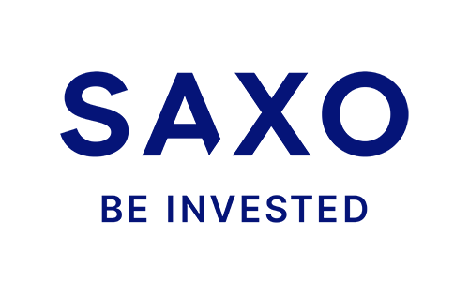
AWS
jbrejnholt
Notes:
The concept of cloud computing emerged in the 1960s with the idea of shared computing resources. However, it wasn’t until the early 2000s that it truly began to take off with the launch of services like Amazon Web Services (AWS) in 2006, offering scalable, on-demand IT infrastructure. Since then, cloud computing has rapidly evolved, becoming a cornerstone of modern digital transformation, enabling businesses worldwide to innovate and scale like never before.

Slide 5





Cloud Computing Benefits
Scalable
Secure
Savings
Flexible
Innovation
jbrejnholt
Notes:
Scalable: Company does good in Black Friday / US election ☺
Secure: Offer secure configuration options
Savings: For small to medium business, avoid upfront hardware expenses
Flexible: Anywhere anytime
Innovation: Not only on-demand hardware and services, but something so specialised like ML/AI, making it accessible to everyone without having a team of data scientists.
Can you imaginate how our executives react when they are seeing this list?
Cloud computing is the on-demand delivery of IT resources over the internet, offering flexibility, scalability, and efficiency. By leveraging cloud services, businesses can access computing power, storage, and applications without the need for traditional on-premises infrastructure, enabling faster innovation, cost optimization, and seamless scalability to meet evolving business demands.
Cloud benefit ref
https://azure.microsoft.com/en-us/resources/cloud-computing-dictionary/what-is-cloud-computing/

Slide 6

jbrejnholt
Notes:
What are we waiting for?

Slide 7




Journey
Platform v1
Platform v3
2017
2019
2022
2025
Cloud!
Platform v2
jbrejnholt
Notes:
Outline Saxo Bank’s commitment to open-source technologies and the transition from monolithic to modular architecture.
Discuss the benefits of composability and modularity: easier updates, scalability, and better resilience.
Mention the role of Kubernetes and other open-source tools in supporting this architecture.
2020 realized cloud native != DR, Reliability => GitOps empowered V2
All good? not quite - $, exit, cloud-agnostic => v3, in on prem DC!
Emphasize the importance of security, compliance, and governance in Saxo Bank’s journey.
Describe how open-source adoption is balanced with strict security measures and compliance requirements.
Provide examples of security enhancements implemented during this transformation.

Slide 8

jbrejnholt

Slide 9




jbrejnholt
Notes:
Molly and I lives in a fairy tale land that we can own cars with whatever we like on – well, almost

Slide 10
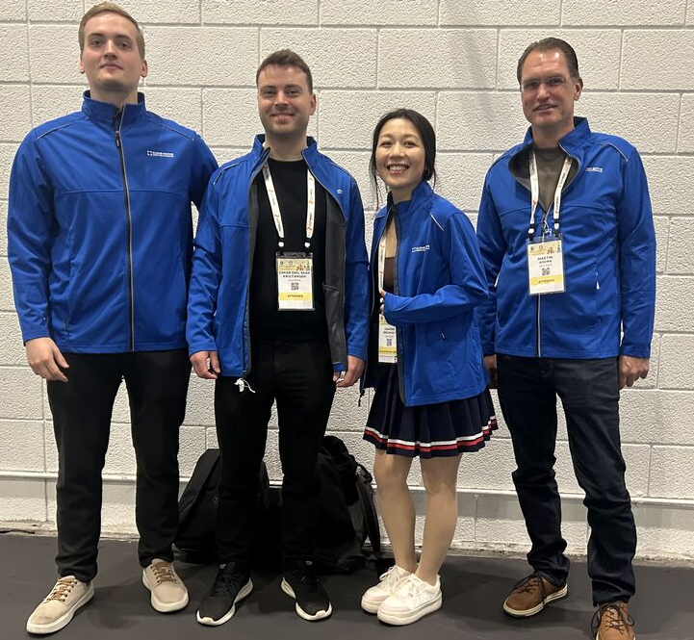
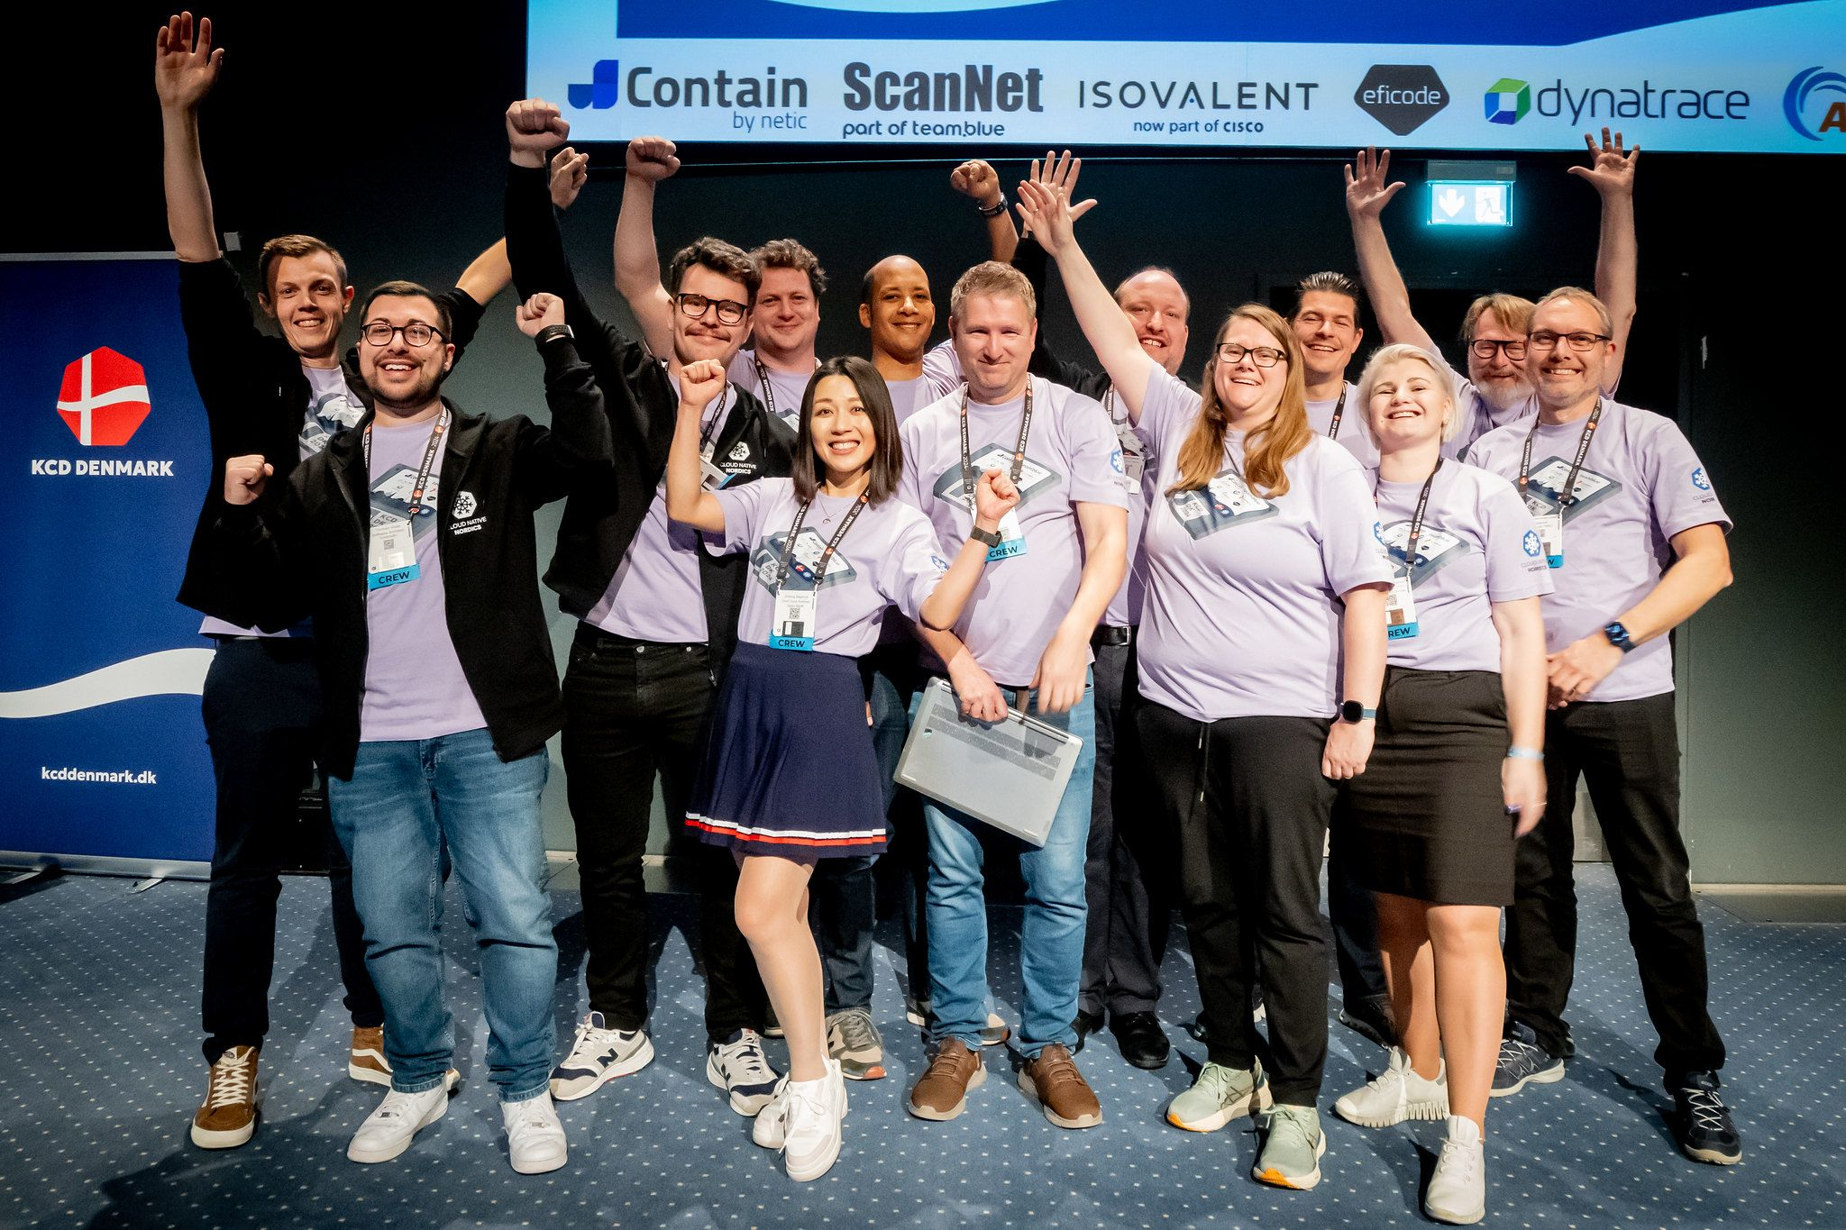

Cloud Native Community
jbrejnholt
Notes:
Encourage Saxonians to learn
Contribute to the community - org
Sharing what we learn

Slide 11

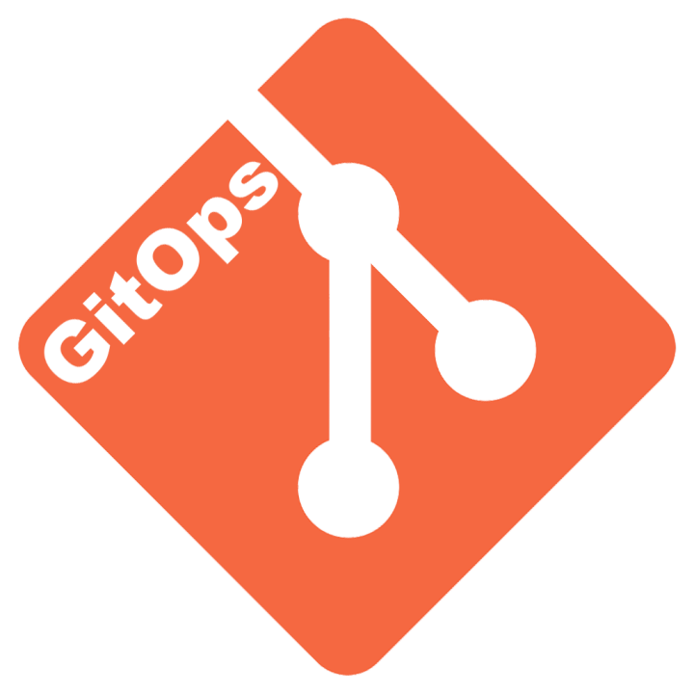


Journey – Closer Look
Platform v1
Cloud Native
Hybrid/Multi Cloud
Platform v3
Container/K8S
K8S Fleet
2017
2019
2022
2025
Cloud!
Cloud Agnostic
Platform v2
SaaS
GitOps K8S
jbrejnholt
Notes:
with that background, now take a closer look with our journey

Slide 12

Cloud Computing Benefits
Scalable
Secure
Savings
Flexible
Innovation
jbrejnholt
Notes:
Wait, Jinhong! How about all these benefits you've just mentioned

Slide 13
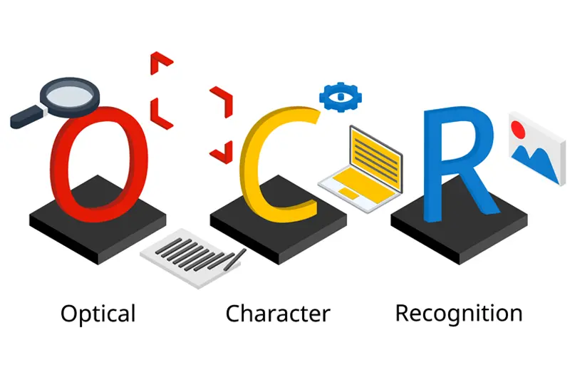
Why
Operational Excellence
Cost Optimization
Regulatory Requirement
jbrejnholt
Notes:
Summerised the reasons to three things - OCR Not Optical Character Recognition
No GPT help

Slide 14
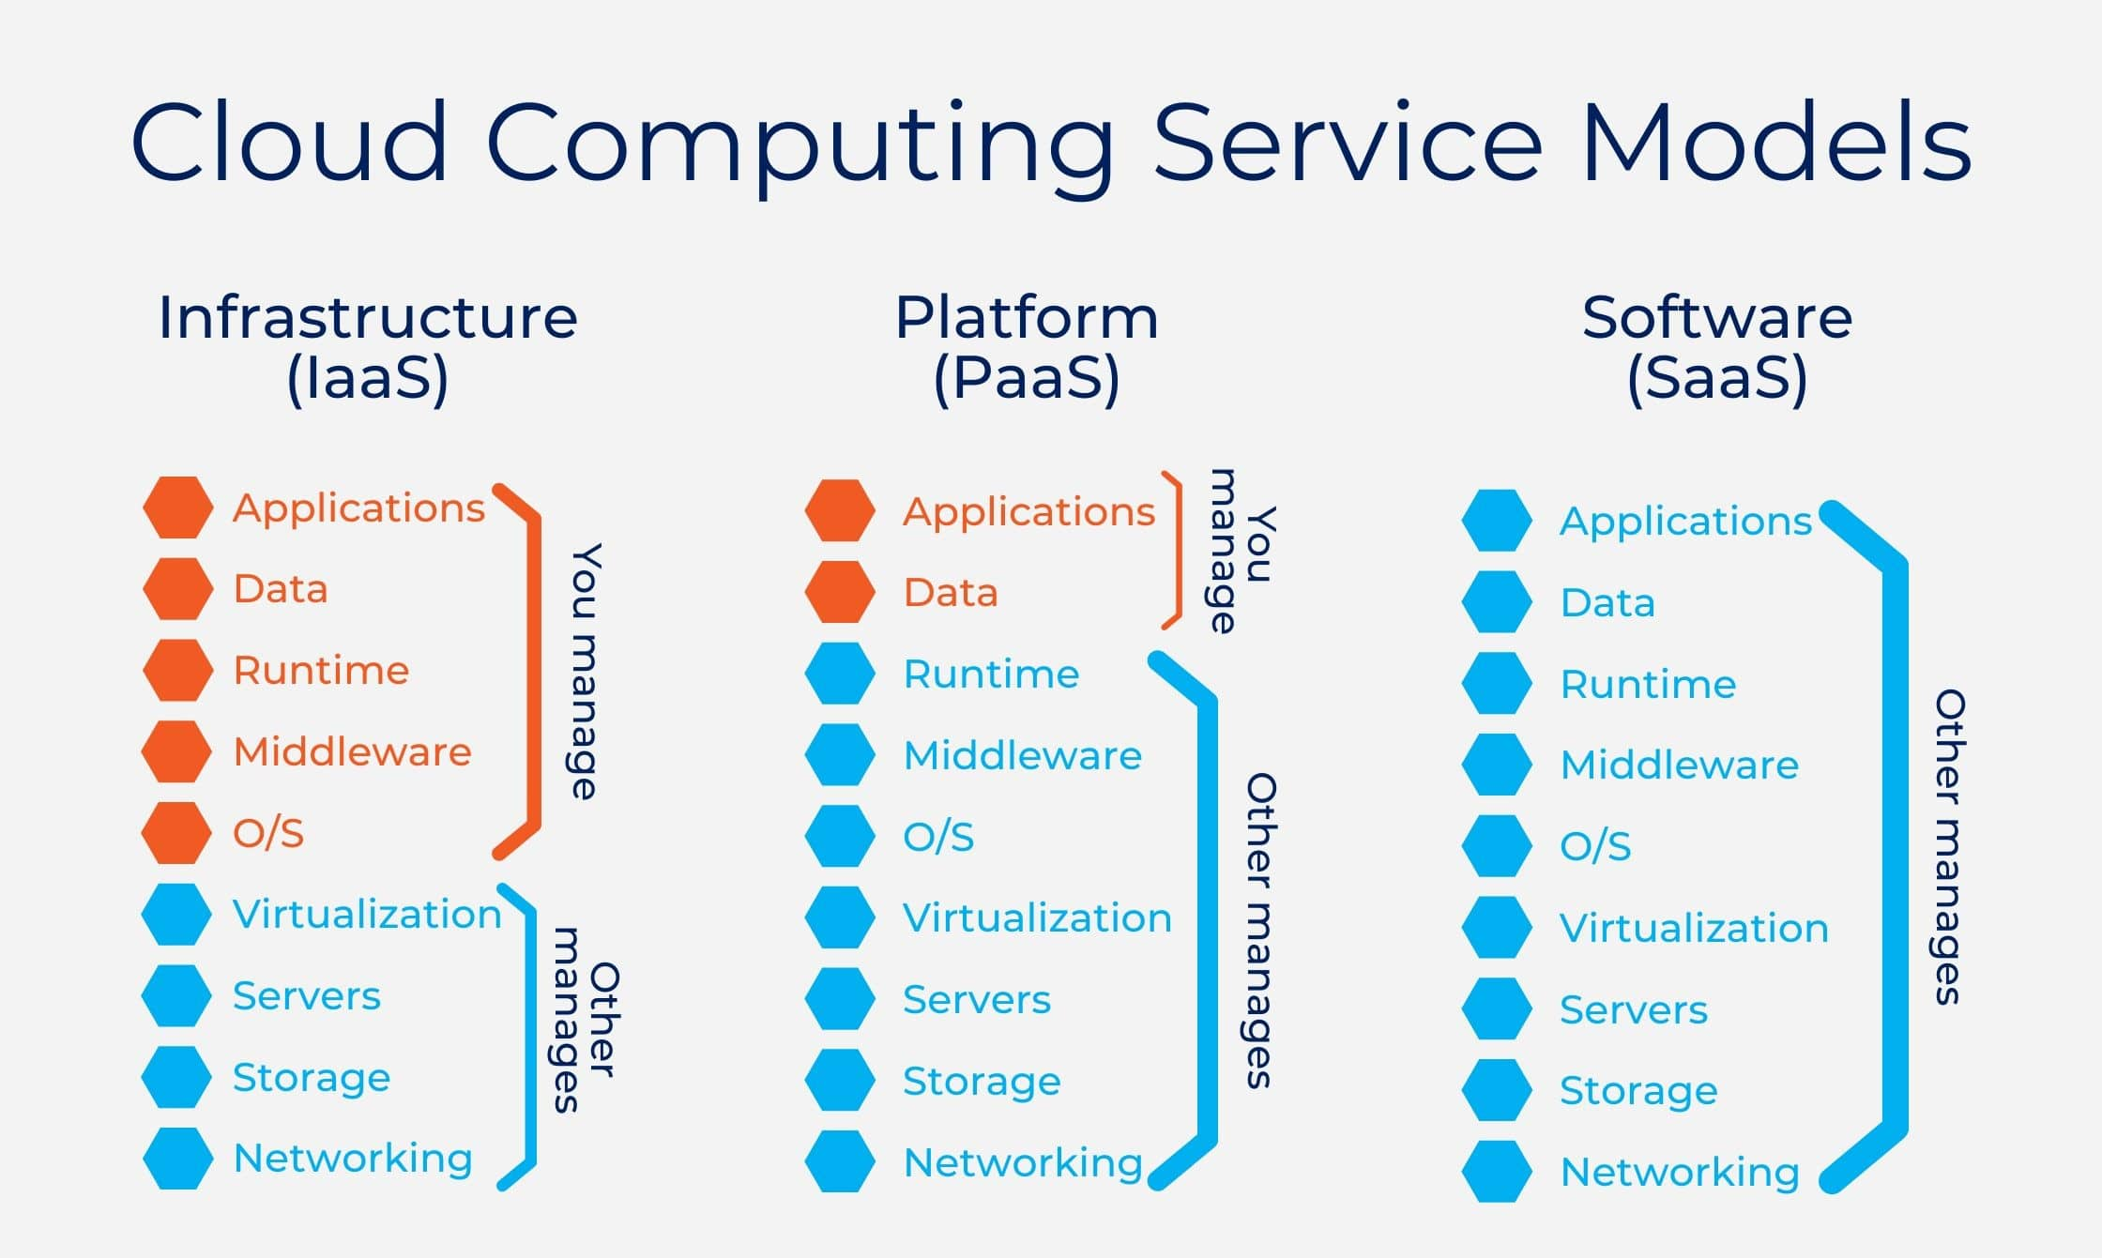

Operational Excellence
MANAGE LESS ≠
WORRY LESS
jbrejnholt
Notes:
Less you manage, less worry
When things go wrong -> support
If you have a capable team -> take care of as much of the stack as you can
IaaS -> turn VM off and on
PaaS -> SLA 72 hours
SaaS -> I can't see any issues from our side - contact your admin

Slide 15
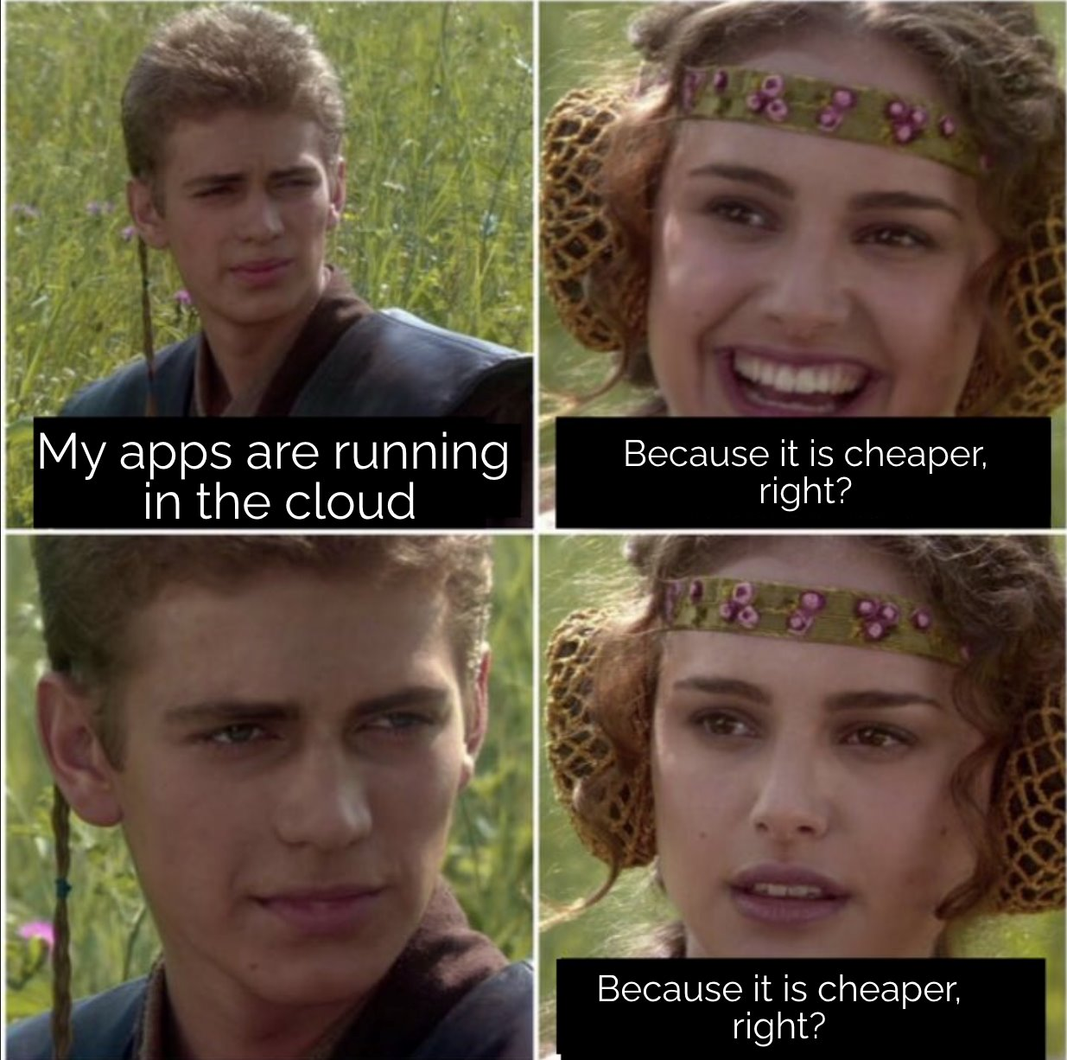
Cost Optimization
jbrejnholt
Notes:
Small to medium - avoid capital investment
Have you done the cost analysis between running software yourself vs in cloud?

Slide 16



VM Instances
Load Balancer
Firewall
Power, cooling & rent
Internet lines
Hardware (Servers, switches)
Express Route
FTE
Traffic
...
Licenses
...
jbrejnholt

Slide 17





Cost Optimization
jbrejnholt
Notes:
run app in 1/7 of the cost

Slide 18


Cost Optimization
jbrejnholt

Slide 19


Regulatory Requirement
jbrejnholt
Notes:
Systemically Important Financial Institution (two year ago)
2023 June

Slide 20

Regulatory Requirement
jbrejnholt
Notes:
Require to stay alive and stay mobile, don't get locked in and can't get out.

Slide 21
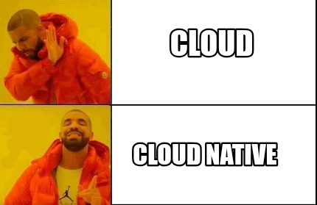
jbrejnholt

Slide 22
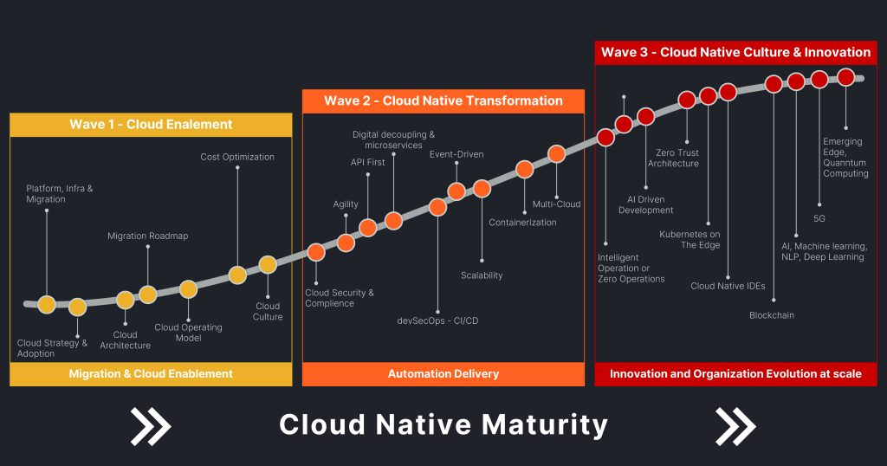
jbrejnholt
Notes:
overwhelming long jounery

Slide 23

jbrejnholt
Notes:
We will do it in the way it fits us

Slide 24





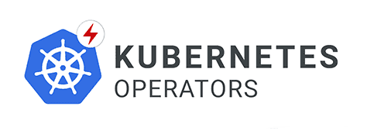










jbrejnholt
Notes:
Tech stack
Container platform Security/observability - awesome at it
ClusterAPI
Kyverno
Grafana
Prometheus
Blueprint (service dependencies and automations) - good at it
role assignment
api offering/consuming
DNS/certificates automation for ex
firewall
Figuering out:
postgres databases in k8s Crossplane for multi-cloud provisioning
AI - we believe we could have done more like everyone else

Slide 25

Cloud to Cloud Native
Multi-Cloud
Hybrid Cloud
Cloud Native
DR & Cost
Cloud-First
jbrejnholt
Notes:
Our cloud journey began with a 'Cloud First' strategy, where we explored the transformative benefits of cloud-native practices — embracing API-driven, modular, and scalable architectures.
As we progressed, we learned valuable lessons and invested significantly in disaster recovery and cost optimization. These efforts have paved the way for us to build a sustainable trading platform.
Click -> we are here. With a hybrid, and eventually multi-cloud approach, we aim to deliver a hosting environment that is cost-efficient, secure, and resilient — empowering our business to thrive in an increasingly dynamic digital landscape.

Slide 26

Your cloud journey?
native
jbrejnholt
Notes:
Helpful

